Slide 1
Education of the Whole Child
Caitlin McMunn Dooley, Ph.D.
Susan Adams

Slide 2
Scope
Title IV Part A Student Support and Academic Enrichment (SSAE) grants
Title IV Part F National Activities
Title IX Preschool Development Grants
Literacy Education for All, Results for the Nation (LEARN) Act

Slide 3
Title IV Part A Student Support and Academic Enrichment (SSAE)
Provide students with a well-rounded education (STEM, civics, IB/AP, health and PE)
Supporting safe and healthy students
Supporting effective use of technology

Slide 4
Title IV Part A Student Support and Academic Enrichment (SSAE)
Block grant
Distribution of funds based on Title 1 allocations
Budget negotiations underway (Anyone’s guess: $1.65 billion to $400 million…)

Slide 5
(American History and Civics)
Presidential and Congressional Academies
Awarded to non-profits, research centers, museums, libraries, and institutes of higher education
Award for outstanding students of American history and civics

Slide 6
Title IV Part F National Activities
Competitive grant
Grants for education innovation and research
“fund development, implementation, and feasibility of testing of a program, which prior research suggests has promise, for the purposes of determining whether the program can successfully improve” learning

Slide 7
Title IX Preschool Development Grants
Continuation of current program
Competitive grant
Enhance preschool infrastructure to enable delivery of high-quality preschool programs in targeted communities

Slide 8
Literacy Education for All, Results for the Nation (LEARN) Act
Will take the shape of the current Striving Readers Comprehensive Literacy (SRCL) grant with few changes
Competitive grant
Georgia will compete
Allocation is under negotiation

Slide 9
Unique Charge for our Committee
Establish guiding principles without knowing what the Request for Proposals (rfp) will look like
“Offering a holistic education for each and every child in the state”
Think BIG!

Slide 10
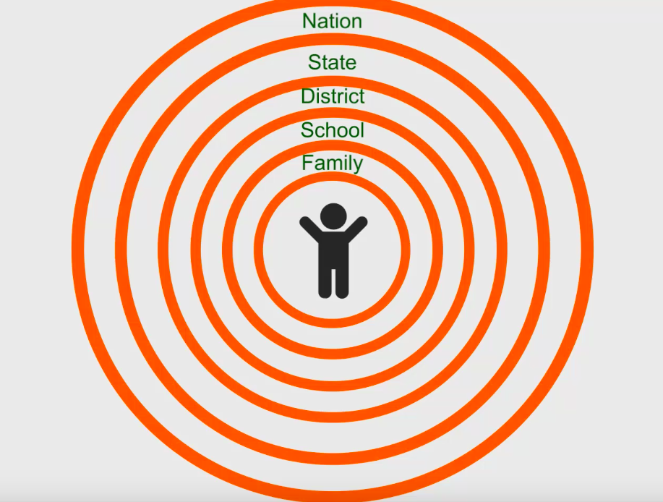

Slide 12
Save the Dates!
August 24, 10-1 face to face (lunch provided)
Sept 14, 10-1 face to face (lunch provided)
October 19, 10:30-12 online
Nov. 9, 10-1 face to face (lunch provided)

